Slide 1
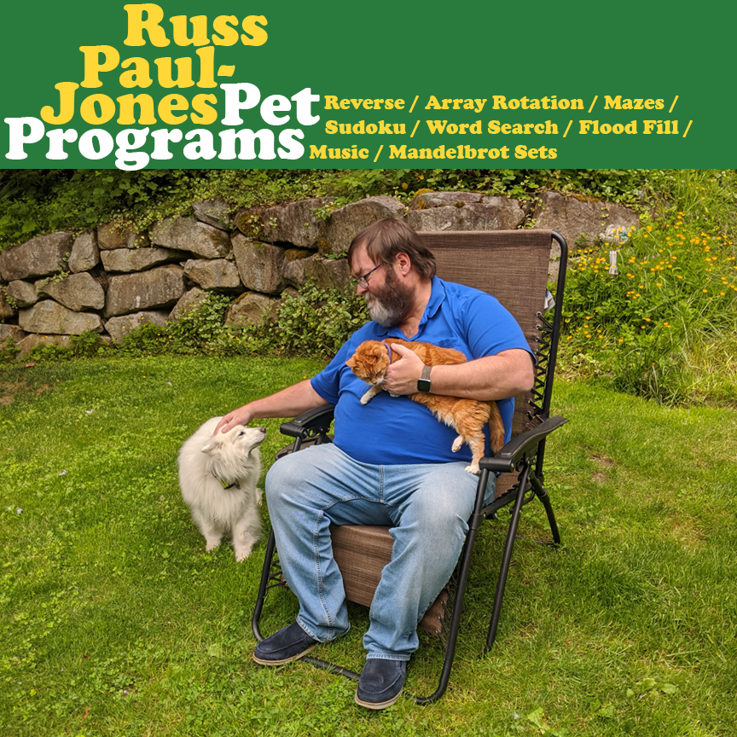
Pet programs
Russ Paul-Jones
May 21, 2020
North creek and Woodinville High Schools

Slide 2
Pet programs
I suppose every programmer has some favorite programs that they are fond of over a long time. These are some of my pet programs, some of which I've been writing for over forty years. They are familiar programs that I can use to learn a new programming language or computer environment, and most of them have found their way into my collection of interview questions over the years. Let me tell you why these are some of my favorites, and I'll tell some stories behind these programs that have made them my special pets.
I hope you walk away with the understanding that you, too, could have some pet programs to help you navigate your continued education and enjoyment with Computer Science.

Slide 3


Russ Paul-Jones
I have been programming since 1977, when I found the computer lab at Cascade High School. I working with computers ever since, sometimes as a student, and mostly as a professional.
I received a degree in Computer Science from the University of Washington in 1987.
I have worked at companies in size from startups to Microsoft, as a programmer, architect, and development manager. I am currently working as a Development Manager at the Tableau Division of SalesForce.
After all these years, elegant code still makes me very happy, and I am lucky that I get to work with it every day.

Slide 4
Russ paul-jones
russ@paul-jones.org
I’m on LinkedIn
Github at https://github.com/russpj

Slide 5
What are pet programs for?
They are just fun
Learning a new programming language is easier if you have a familiar project to use as a tutorial
I’ve collected interesting algorithms and data structures to use for interview questions
I like to written solutions to any questions I ask, since that gives me the experience to guide and evaluate the applicant
And sometimes I’ve learned them in interview questions

Slide 6
Table of Contents
Maze programs
Maze Generators in BASIC
Maze Solver in BASIC
Learning Java with Mazes
Array Rotation
The first interview question I invented
Word Search in Python
Flood Fill in Python
Computer Music in C
Mandelbrot Sets in C++

Slide 7
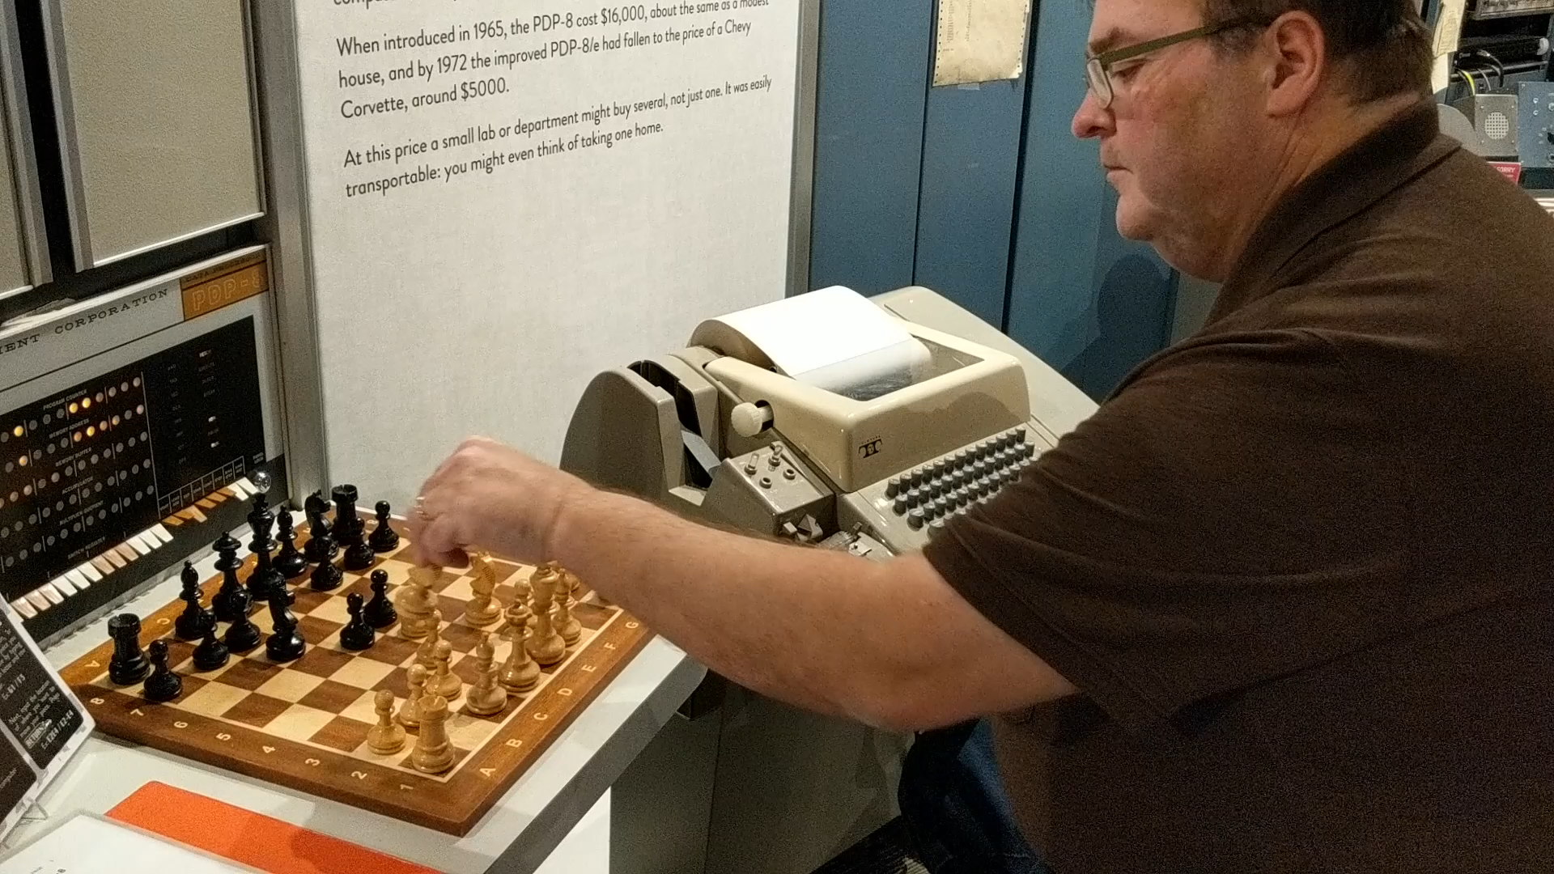
State of the art – 1977
I was a freshman in High School
Mysterious room in the Math building
Full of a mechanical noise and the smell of working machinery
You can see almost exactly the same machine at Seattle’s Living Computers Museum

Slide 9
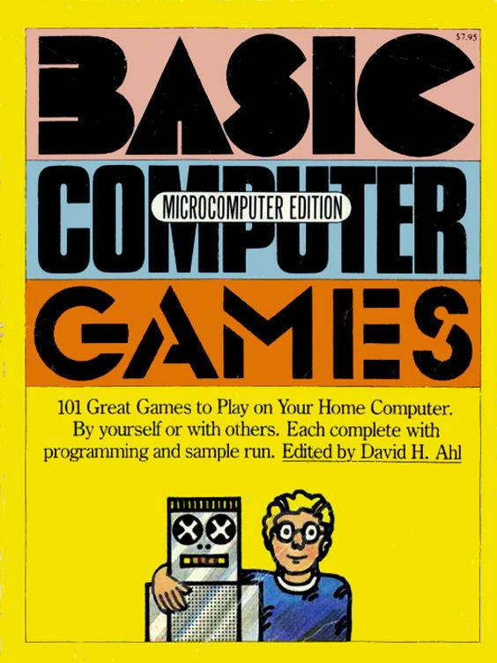
High School
Diving into BASIC
We didn’t have the internet, we had books
Number guessing, adventure games, Amazing
All text-based

Slide 10
AMAzing
The IBM-PC was released in 1981
I had access to them through work, University, and friends
Included BASIC programming language
Now there is an emulator written for Windows
I ported the version from the book to the IBM version of BASIC
But I never understood the algorithm (the code is very hard to read)
Demo with original teletype friendly version

Slide 11
Amazing
Around 1984 I converted it to use the screen graphics available at the time
320x200 pixels, four glorious colors
And I added my own code, to allow the computer to solve the maze
It’s often easier to understand your own code
Demonstration

Slide 12

Maze Solver
Solving a maze is an example of a search with backtracking
At each junction, follow one of the paths you have not tried before
If you get to a dead end, back up to the previous junction
If there are paths you haven’t tried, try one.
If at any point, you get out, you have solved the maze!
Otherwise, keep backtracking and trying other solutions
Follow the right-hand wall is a way of automating that process
I use this at corn mazes to solve the maze without looking at the map

Slide 13
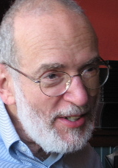
Dr. Stephen Garland
Last year, when I recovered my version of the BASIC Amazing program, I did some research on its origins
The version from the book is very hard to read and understand, but I found another version with comments that explain what the variables are, and what steps the code sections represent
I also found an additional author, S. Garland, and further research lead me to an email address for him
I have had some interesting email conversations with him. He is still interested in mazes and follows the right hand wall when solving life-sized ones!

Slide 14

Java Version
Recently I wanted to learn the Java programming language
I had learned something about the theory behind mazes in University
Start with a set of rooms (nodes) that are not connected.
Start with some room. Test the rooms that are up/down, left/right. If one of those rooms has not been visited, make a passage (edge) to that room. Go into that room, and repeat.
If there are no unvisited rooms nearby, backtrack until you find a room with unvisited neighbors.
This creates a spanning tree of this graph, which is singly-connected (there is only one path from any two rooms in the maze)
I wrote a Java program that created mazes (and solved them, of course)
And just a few months later, I was asked the maze solving question in an interview
I told them I had been working on that for over 30 years!
Demonstration

Slide 15
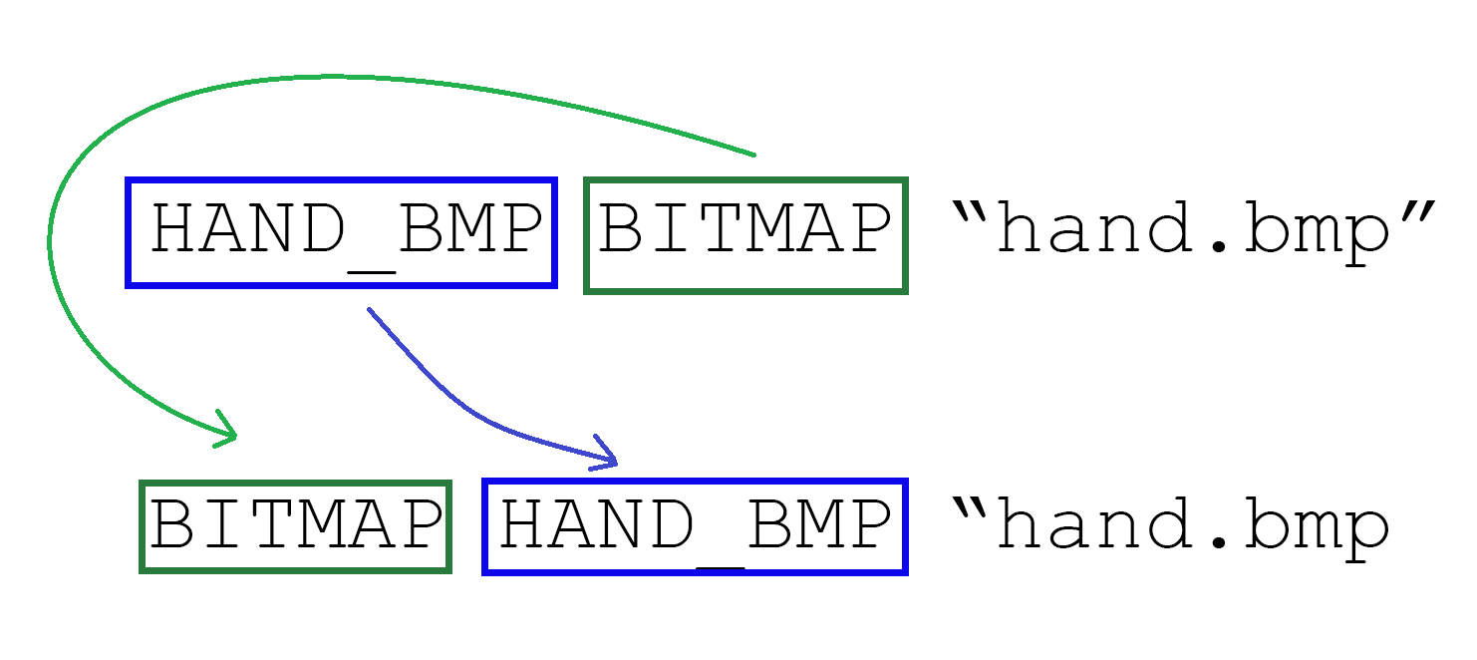
Reversing and rotation
This is the first interview question I invented, around 1990 or so
Based on an actual problem that I had at work:
We needed resource files for two different operating systems
Some lines were almost the same, just with the words in a different order
Given a text string, HAND_BMP BITMAP ‘hand.bmp’
Produce the string, BITMAP HAND_BMP ‘hand.bmp’
I realized that if I could just rotate the characters in the string, I could convert one line into the other
In those days, memory was dear, and computers were slow, so we tried not to use extra memory. The idea here was to do the rotation in place.

Slide 16
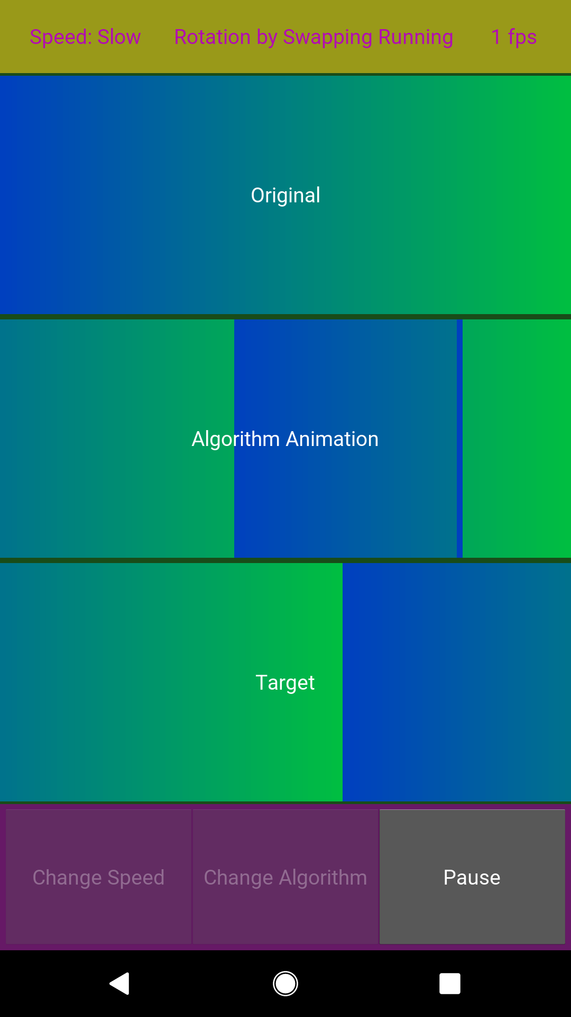
Reversing and rotation – Why Python?
Python is an interesting programming language for scripting, text processing, and more general computing.
For example, that PC-BASIC interpreter I used earlier was written in Python
I had already written these in Python before, but for these demonstrations, I wanted animations of the algorithms
I found a library with good graphics that works across platforms
I even have these demos on my phone
Many programming languages and environments are available on many platforms today, for free
Demonstration

Slide 17
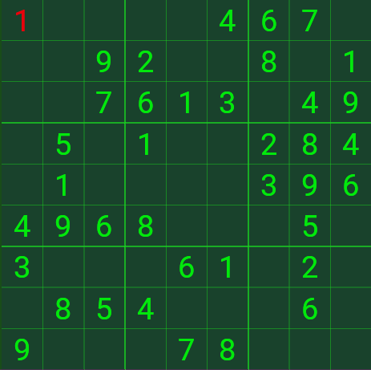
Sudoku Solver in Python
Sudoku can also be solved with a backtracking program
Rules of Sudoku
Sudoku is a 9x9 grid, split up into 9 3x3 squares
You place a number between 1 and 9 in each location on the grid
Numbers cannot match another on their row
Numbers cannot match another in their column
Numbers cannot match another in their 3x3 square

Slide 18
Sudoku Solver in Python
Python is an interesting programming language for scripting, text processing, and more general computing.
For example, that PC-BASIC interpreter I used earlier was written in Python
I had written some of these up in Python before, but for these demonstrations, I wanted animations of the algorithms
I found a library with good graphics that works across platforms
I even have these demos on my phone
The lesson here is that today, many programming languages and environments are available on many platforms
Demonstration

Slide 19
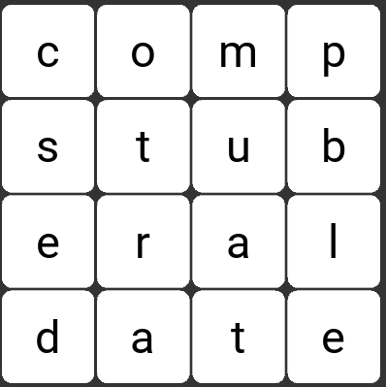
Word Search in Python
Boggle is a word search game
Rules
16 letter blocks are placed at random on a 4x4 grid
You can connect letters up/down, left/right, and diagonally
The goal is to connect letters to form real words
Scoring is based on the length of the word, or the value of the letters
WordBlitz is a variation of this game on Facebook; I play Wordament on my Android phone

Slide 20
Word Search in Python
You can solve this with a backtracking program again
But you might need to think about how efficient you can make the search
This makes it a great interview question
This is common in interviews. The first iteration gets to a solution, but the interviewer will ask for improvements such as better performance or added features. I’ve been using it for about 15 years.
Demonstration

Slide 21

Flood Fill in Python
These backtracking solutions have been examples of depth-first searching
Flood fill is an example of a breadth-first search
Breadth-first search is important in social networks, maps, and other applications where finding shortest paths (or paths of a specific length) is important
Demonstration

Slide 22
Computer Music in C
Programming should be fun
As an elective in University, I took a computer music class
We generated digital music samples with a program system written in FORTRAN
I generated the score for this composition in BASIC, of course
The digital output was converted to analog and recorded on cassette tape
I have a copy of the tape, but not the original score
The Music program we were using has been converted to C
Lately I’ve been going on from where I was, recreating the score and instruments (using Python for generating the score)
It’s a work in progress

Slide 23

Mandelbrot Sets in C++
Programming should be fun
Mandelbrot sets are formed by looking at the repetition of the complex function, f_{c}(z) = z²+c
Fractals were very popular in the 80s
I wrote a Mandelbrot Set generator in Modula-2
But it was slow. Runs would take hours (for 640x350 16 color graphics), so I often left my work computer overnight. I also used my colleagues’, so they would come in in the morning with striking graphics on their machines as a little gift
Recently, I wanted to write a native Windows program in C++, and thought of this
This is another work in progress, and the performance is not very good yet. But it is creating 2000x1440 2048 color images in seconds, because processing has gotten that much faster in 34 years.

Slide 24
Questions?

Slide 25
Education Questions
Where did you study and why did you choose that place?
How did you know computer science/programming was something you wanted to do with your life and once you knew, how did you get to where you are now?
What was college life like for Computer Science? How did you get into Computer Science and relate into your everyday life?
How did you know what you wanted to do?
What skills should we as high school students work on to help us later on when we get jobs? How do we start and develop personal projects while also learning new things?
What methods do you use to learn a topic through self-studying?
How does technology impact our lives today and what does it can AI do for us in the future?
How do you advance yourself alongside technological advances? Is it possible to lose your job because you're not knowledgeable enough in a certain topic that wasn't expected when you started your job?

Slide 26
History Questions
What programs does Russ mainly use for coding?
What coding languages stand out to you and why? Are there any new languages that you have been wanting to learn and work with but haven't had the time to yet?
What are some challenges you faced along the way?
How is computer science different now than back then?
How does it feel watching technology evolve to this day, how different is it?

Slide 27
Job Questions
How hard is it to get a job?
How does the work environment and daily life differ between startups and larger companies?
Any tip for students looking to start/join a startup?
Did you do any internships, what types of coding languages do you know and what languages are being used in companies often so its worth knowing?
What skills and talents helped you succeed and/or would you look for in a potential employee?
What types questions do you ask in an interview?
What is the hardest part of your job?

Slide 28
Program Questions
How do you choose what pet projects to start? How do you keep yourself motivated with a pet project? Do you use them to fluff up your github (lol)
What is your favorite Pet Project
What is your favorite program?
What are pet programs and why are they important?
What are some of your pet projects, and how did you come up with the ideas for these pet projects?
What is a pet project? Why are they important?
The specific details on why we should have pet programs
How did you start building your pet programs?

